Slide 1
A PEOPLE’S POSTAL AGENDA
Sarah Anderson
Institute for Policy Studies
March 16, 2021

Slide 2
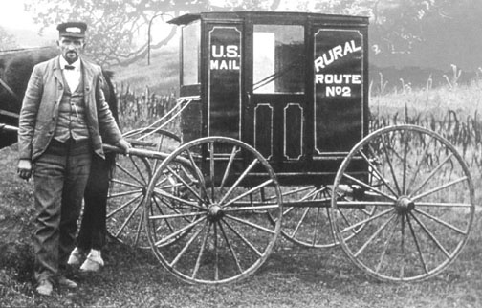
postal service has long been a driver of innovation
1897: rural free delivery
knit rural and urban communities together
expanded markets and grew the economy

Slide 3
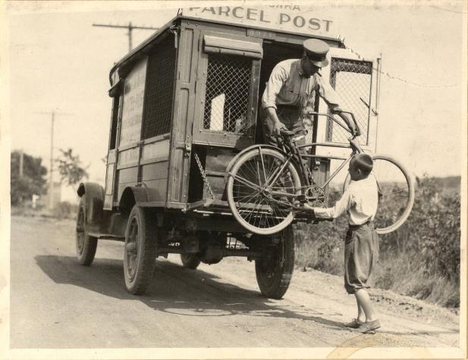
1913: Parcel Post
Created the mail-order catalog industry
Laid the foundation for today’s e-commerce.

Slide 4
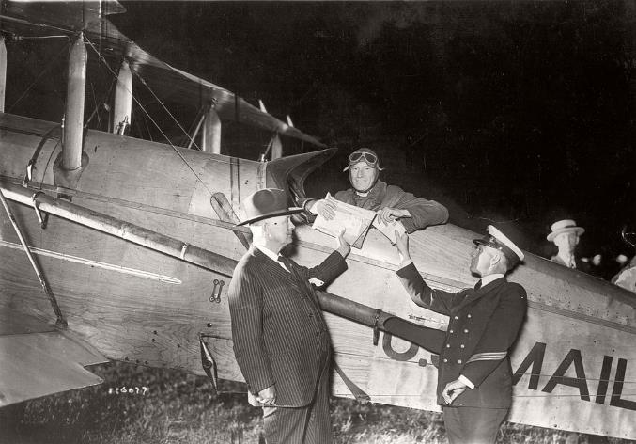
1918: air mail service
Sped up deliveries
Laid the foundation for the commercial aviation industry

Slide 5
WHERE DO WE WANT TO GO in the 21st century?

Slide 6
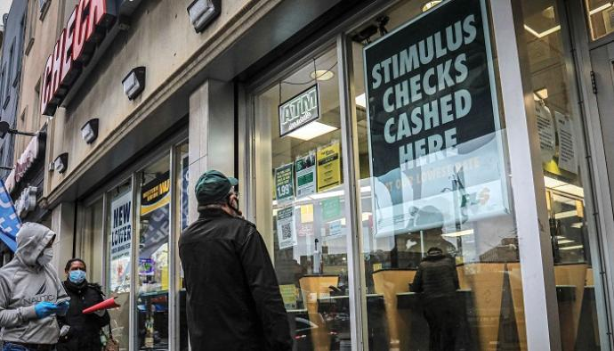
ProvidE affordable financial services

Slide 7
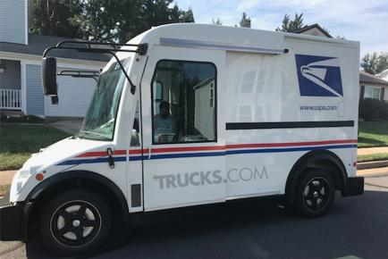
Shift to a clean renewable energy economy
Making our economy more sustainable

Slide 8
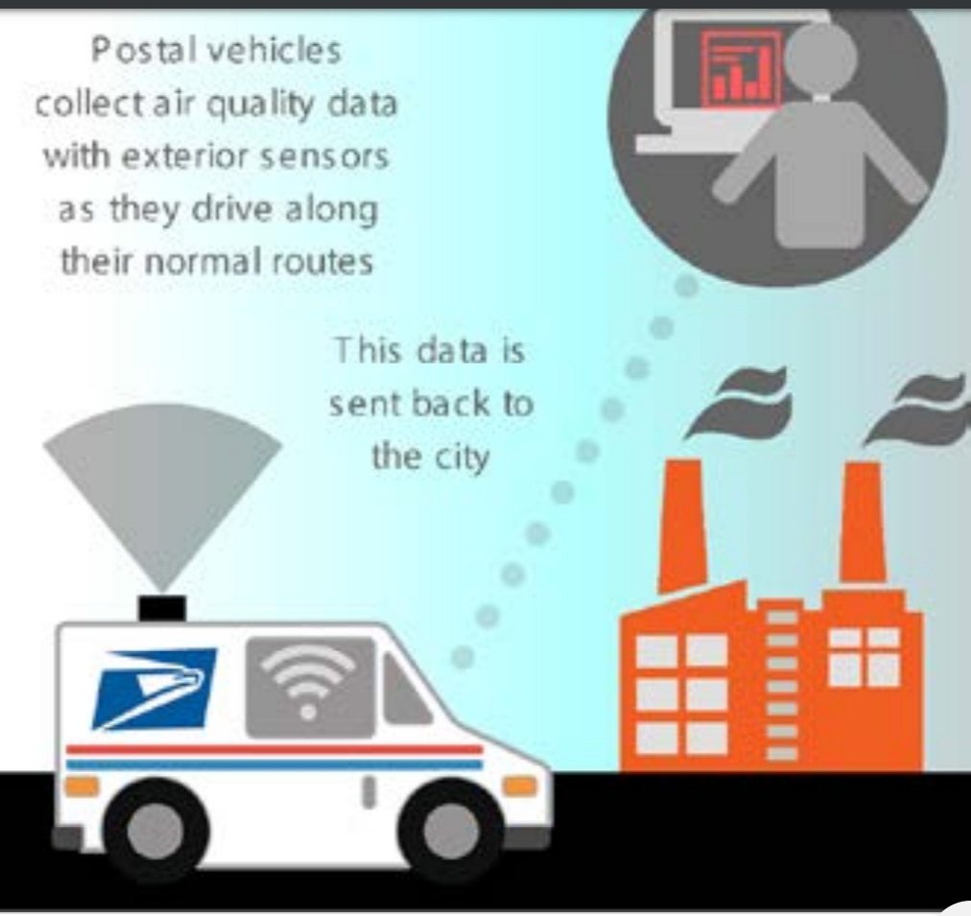
Make communities safer and governments smarter
Postal vehicles collect air quality data with exterior sensors as they drive along their normal routes
This data is sent back to the city

Slide 9
Strengthen our care infrastructure
Notes:
This is the French program. Photo: Veiller sur mes parents – French program

Slide 10
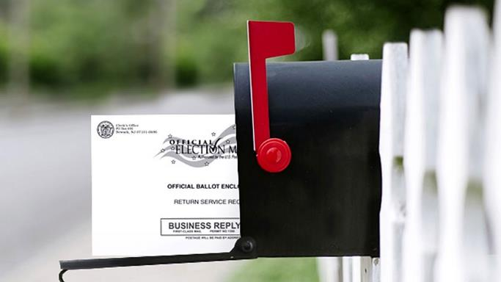
Protect our democracy

Slide 11
Narrowing the digital divide
NARROW THE DIGITAL DIVIDE

Slide 12
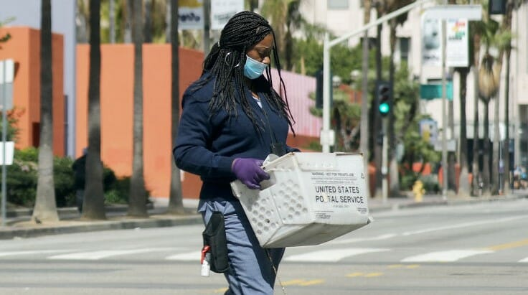
Support good jobs

Slide 13
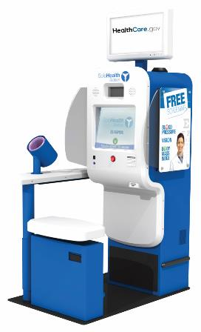
Narrowing the digital divide
Protect public health
Notes:
Could USPS play a role in contact tracing in future pandemics? Post Offices as wellness hubs?

Slide 14
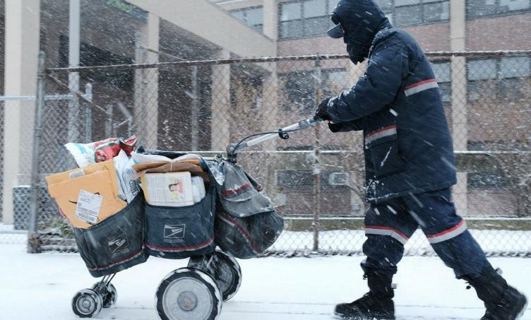
affordable delivery for small businesses & consumers

Slide 15
Support food security and local producers

Slide 16
Building and winning a people’s postal agenda
WHAT YOU CAN DO:
Review the discussion paper (included with your conference reminder email).
Share your thoughts in the breakout sessions over the next few days.
Submit written comments: Brianw@ips-dc.org (deadline: April 1)
Stay connected by signing up for news and alerts: info@agrandalliance.org
Support a launch event and organize collectively around the agenda.

