Slide 1
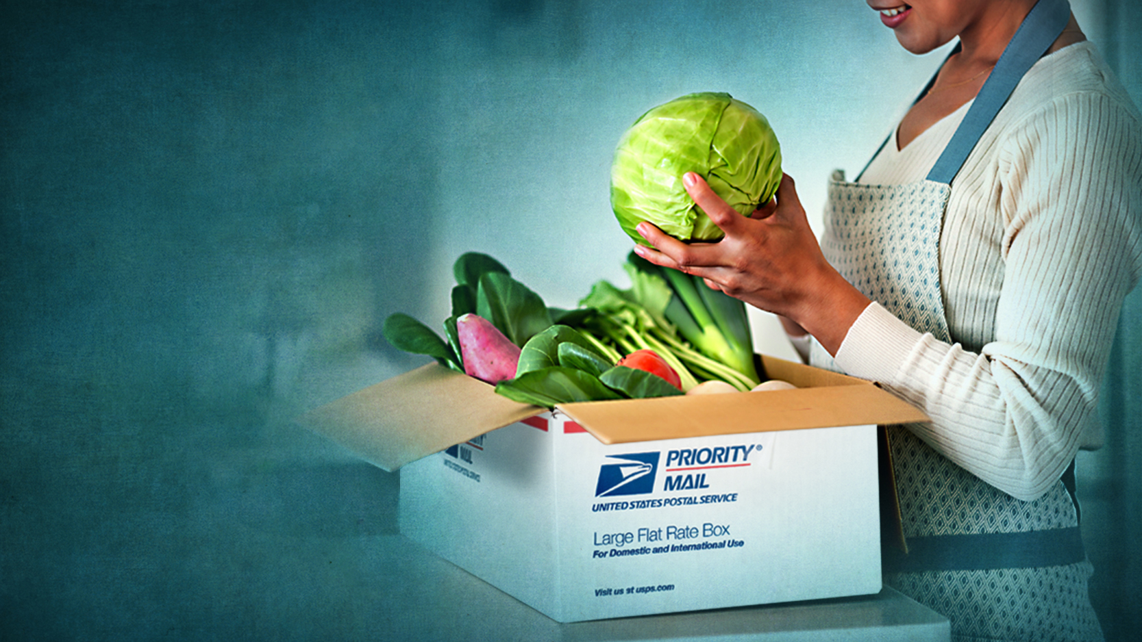
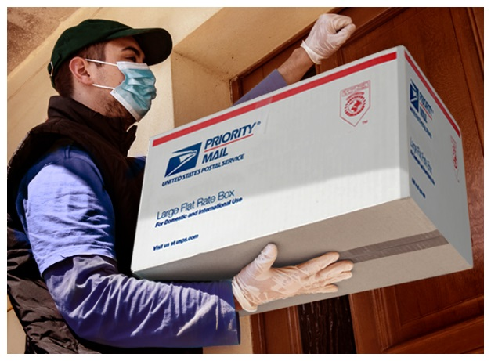
Farmers Post: Delivering Food for All
Julia Kurnik
Director, Innovation Startups WWF-US

Slide 2
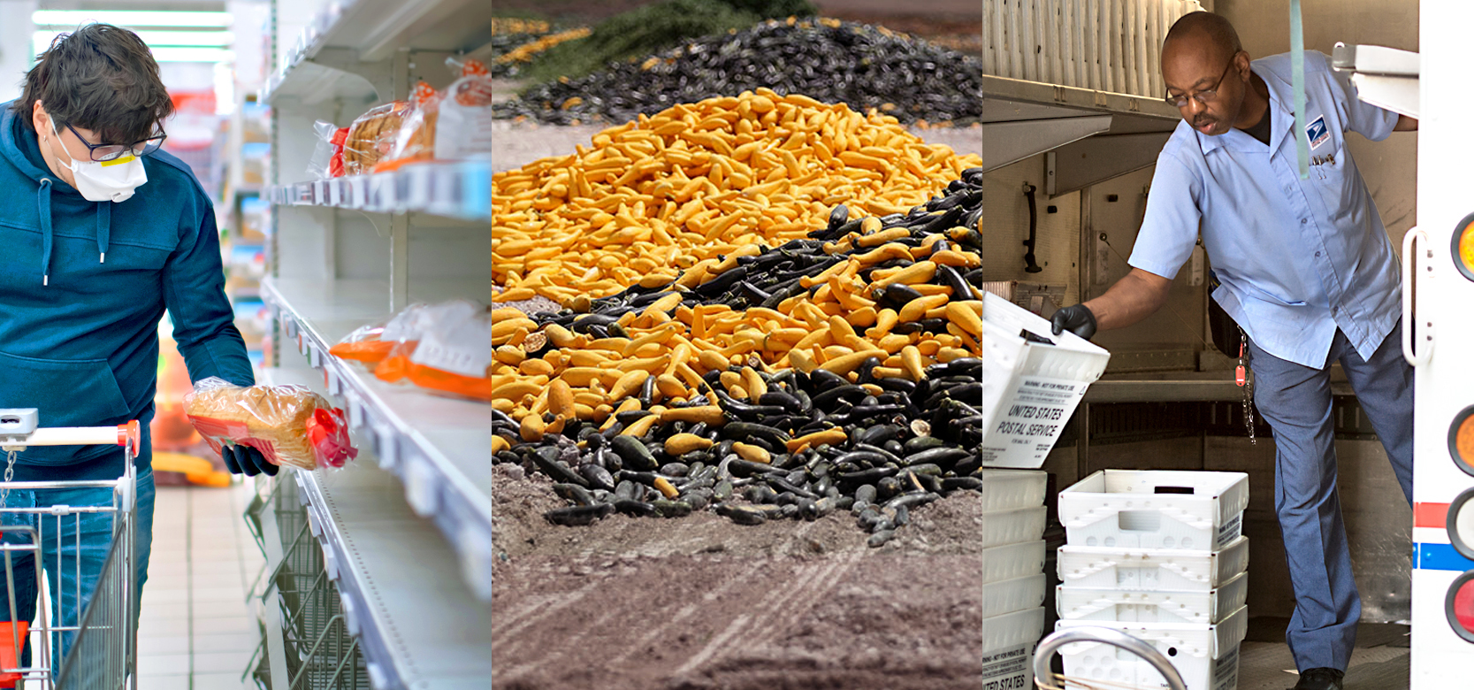
The Issues
Photo: © ArtMarie/ Getty
Photo: © Joe Raedle / Getty
Notes:
Photos:
Center: Politico: https://www.politico.com/news/2020/04/05/food-waste-coronavirus-pandemic-164557 - A pile of zucchini and squash is seen April 1 after it was discarded by a farmer in Florida City, Fla. | Joe Raedle/Getty Images

Slide 3
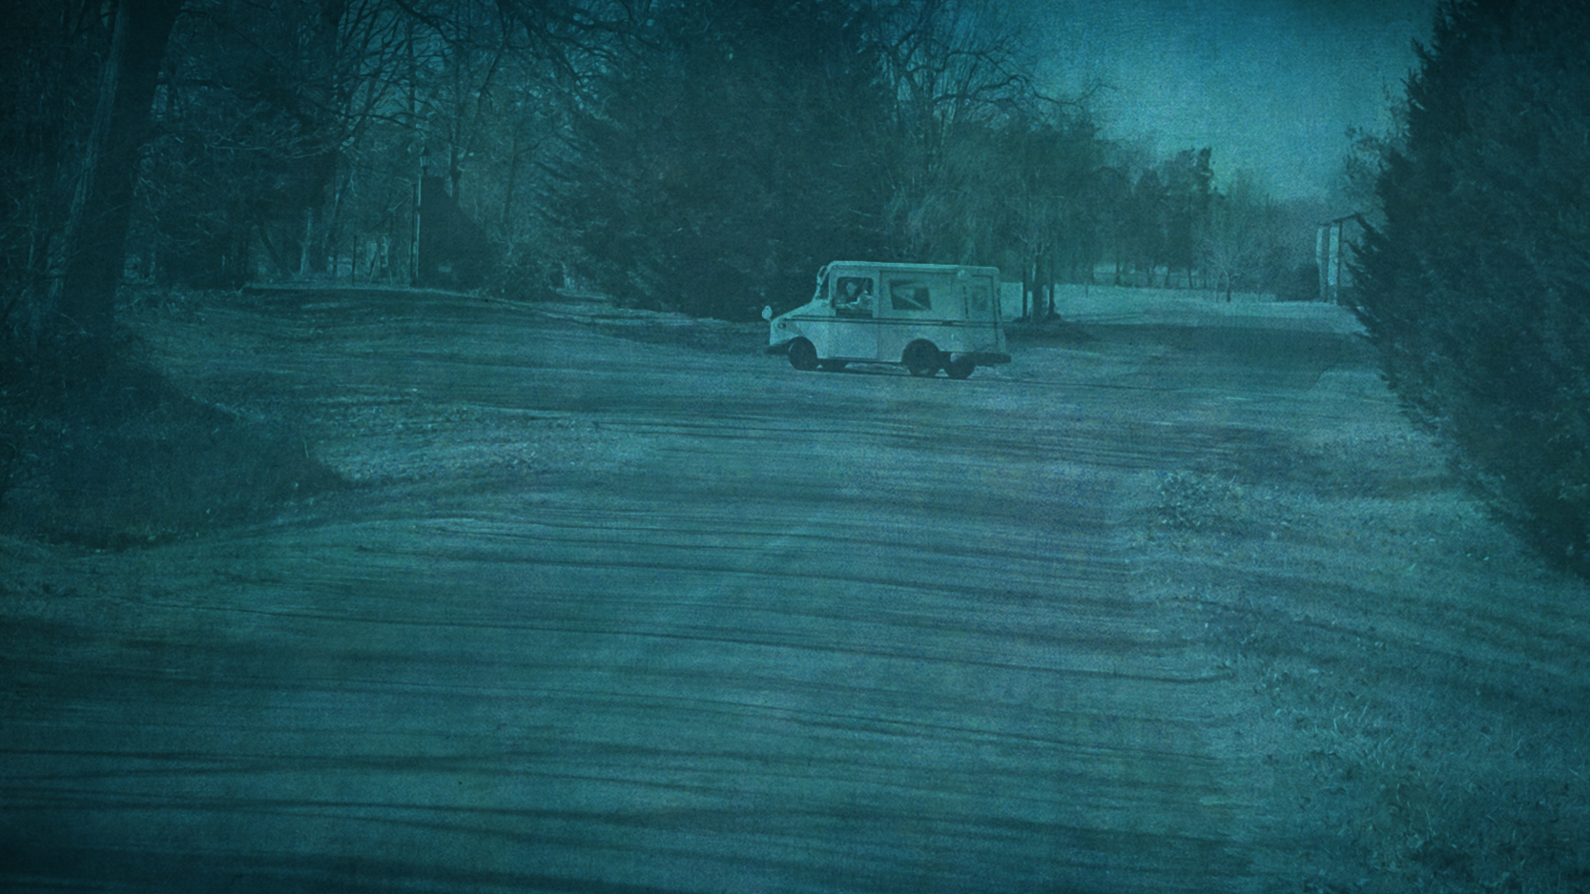
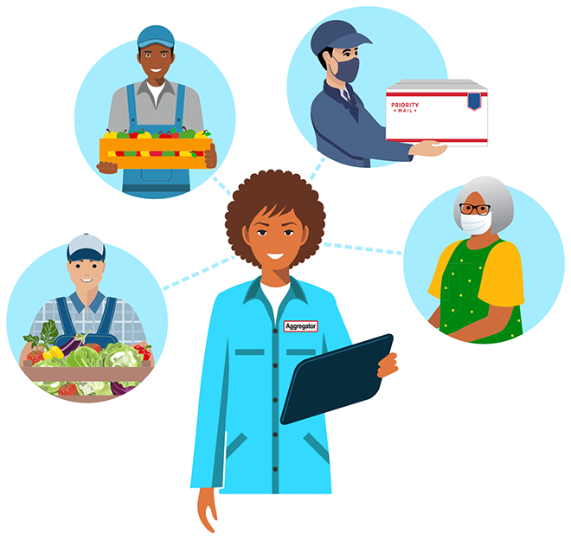
A Solution Farmers Post
Aggregator
Farmer
Farmer to USPS
USPS to customer

Slide 4
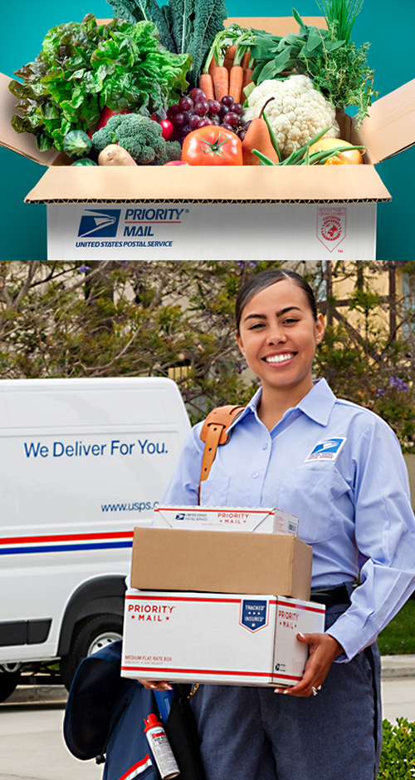
How it works
Based off regional rate system
Delivering in zones 1 and 2
No cold chain
New box size(s)
EDDM for marketing (and sign-up?)
Photo: © USPS.com

Slide 5
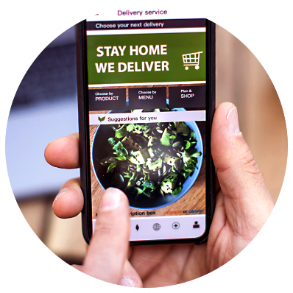
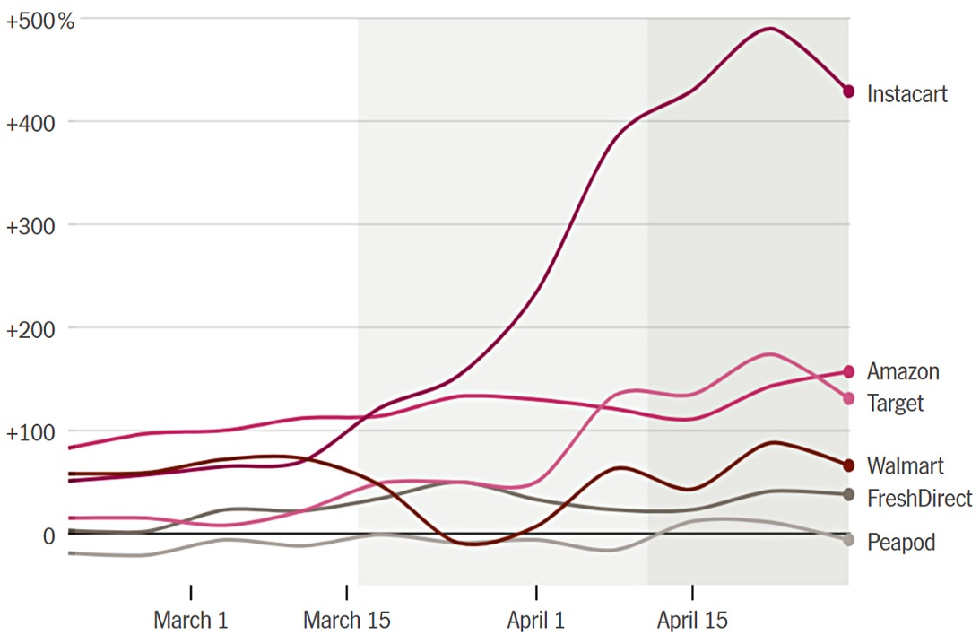
New Market Opportunities
Change in online sales for grocery delivery companies - 2020
Note: Year-over-year change in sales through April 29 · Source: Earnest Research

Slide 6
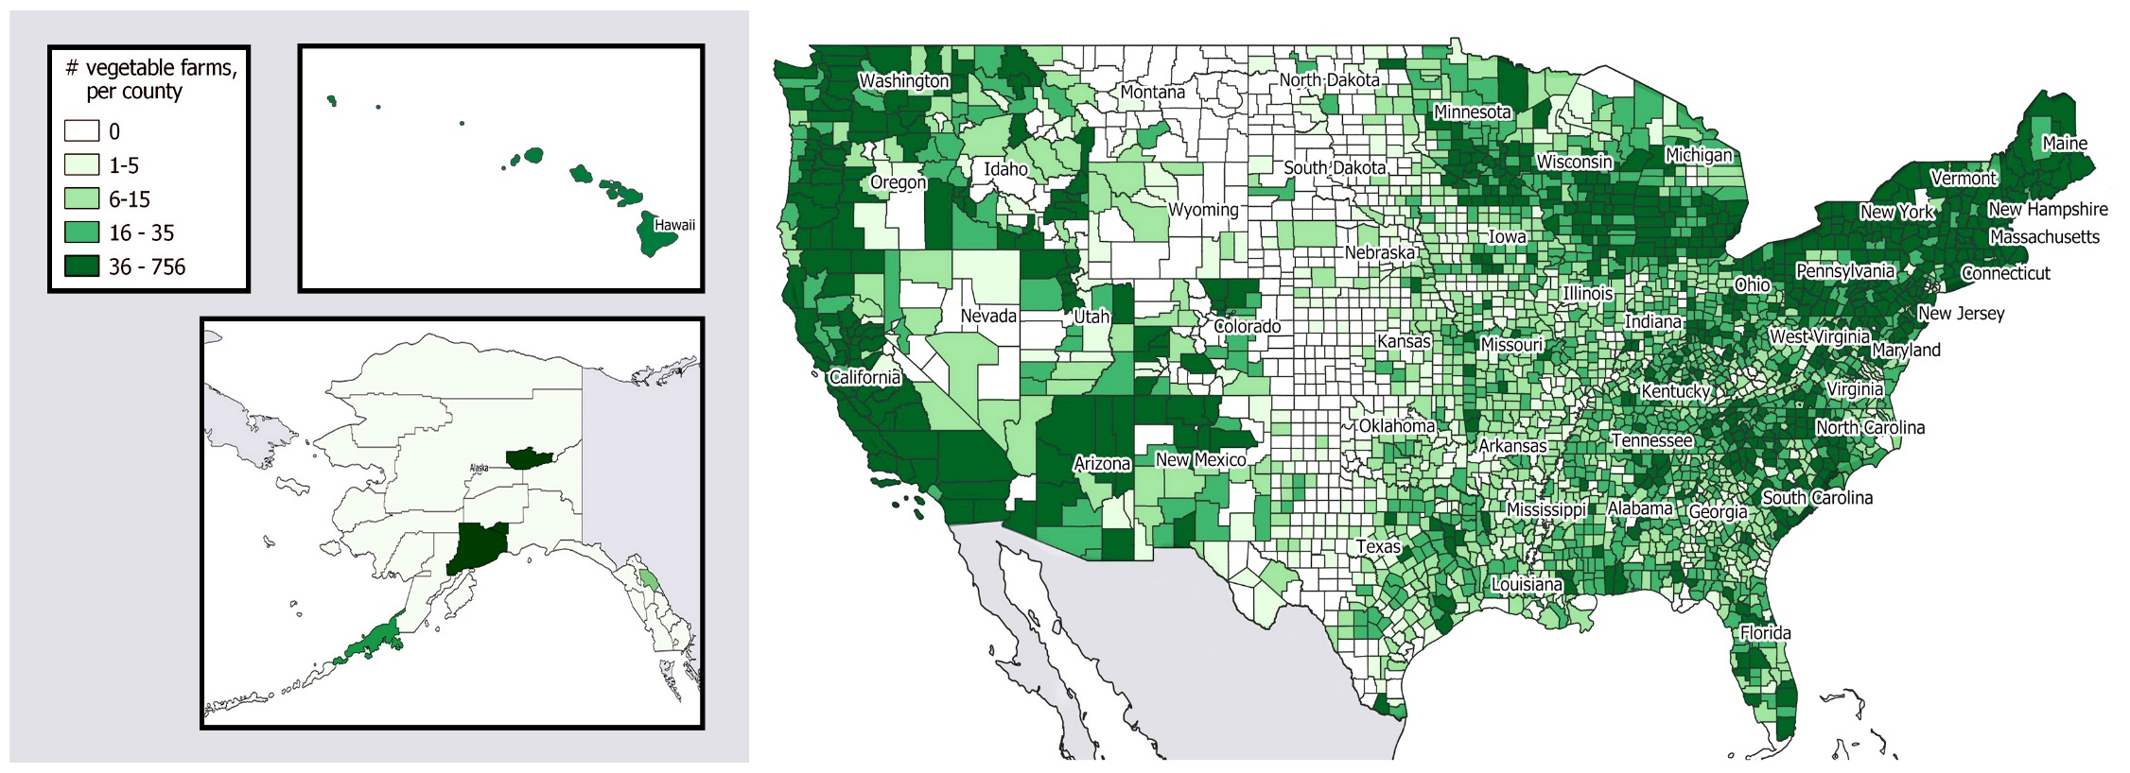
US Vegetable Farms
Source: 2017 USDA Census of Agriculture

Slide 7
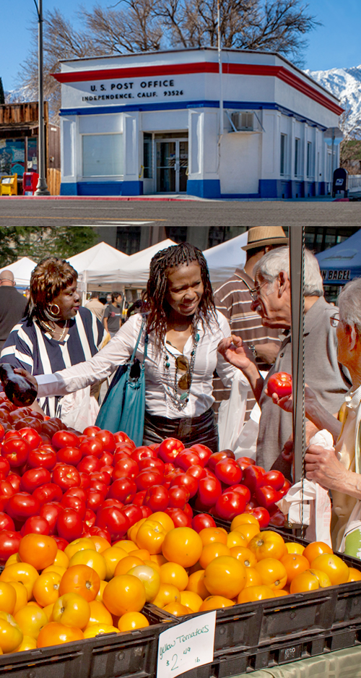
A win for all - USPS
Increased revenue: $1.5B with 2-3% of US population and $6B with 10%
Branding: “Farmers Post – Delivering food for all”
Focus on post office as center of communities
Notes:
Opportunities to focus on post office as center of rural communities – perhaps even build farmers markets and such around them to market the service and build awareness

Slide 8
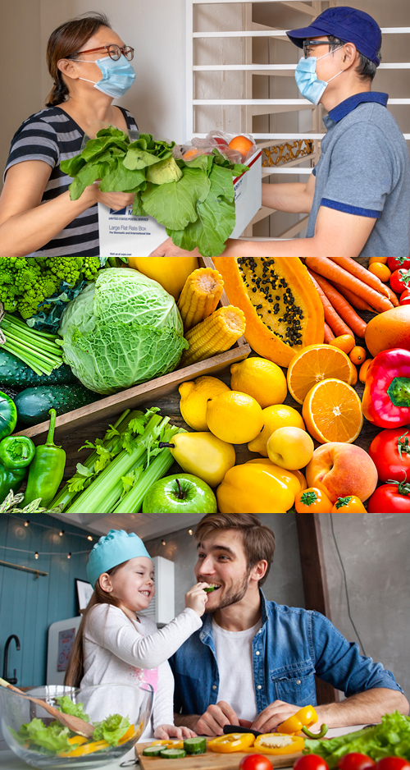
A win for all - Consumers
Fresh, healthy produce
Accessible and affordable food
Nationwide reach and instant scalability
Convenience
Safety
Notes:
Opportunities to focus on post office as center of rural communities – perhaps even build farmers markets and such around them to market the service and build awareness

Slide 9
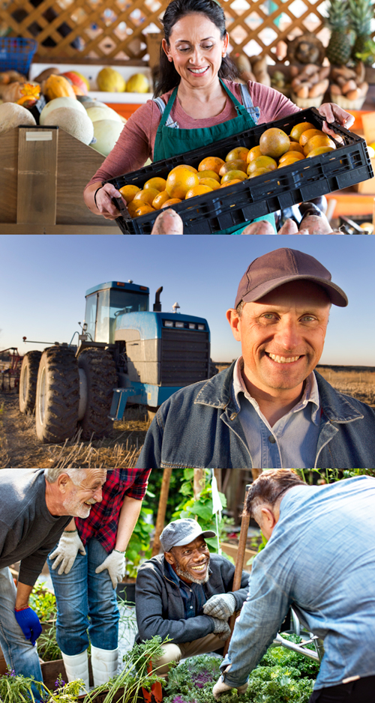
A win for all - Farmers
More revenue
Ability to pivot to new markets
Convenience
Increased certainty
Closely linked to local community

Slide 10
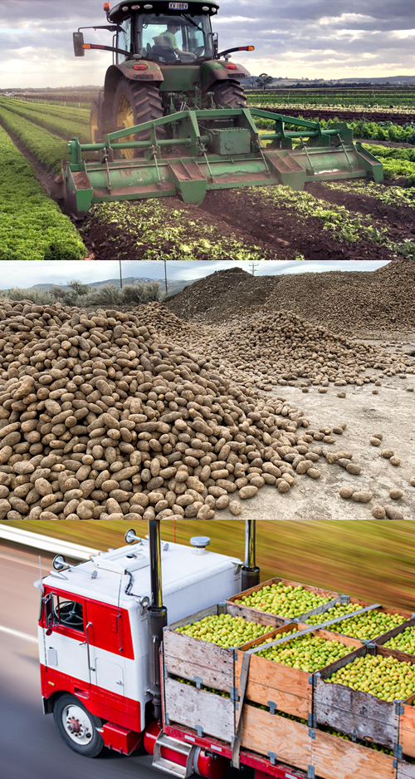
A win for all - Environment
Photo: © theage.com.au
Decreased food loss and waste
2-50% of specialty crops wasted pre-COVID
Using existing asset (USPS)
Low food distribution miles
Photo: © idahomolly
Notes:
Photos: Top: A tractor at Hussey and Co farms in Victoria ploughs vegetables back into the soil due to the pandemic_theage.com.au
Center: Discarded potatoes due to pandemic_Idaho_Photo-Twitter/@idahomolly
so few additional GHG emissions from transportation/delivery

Slide 11
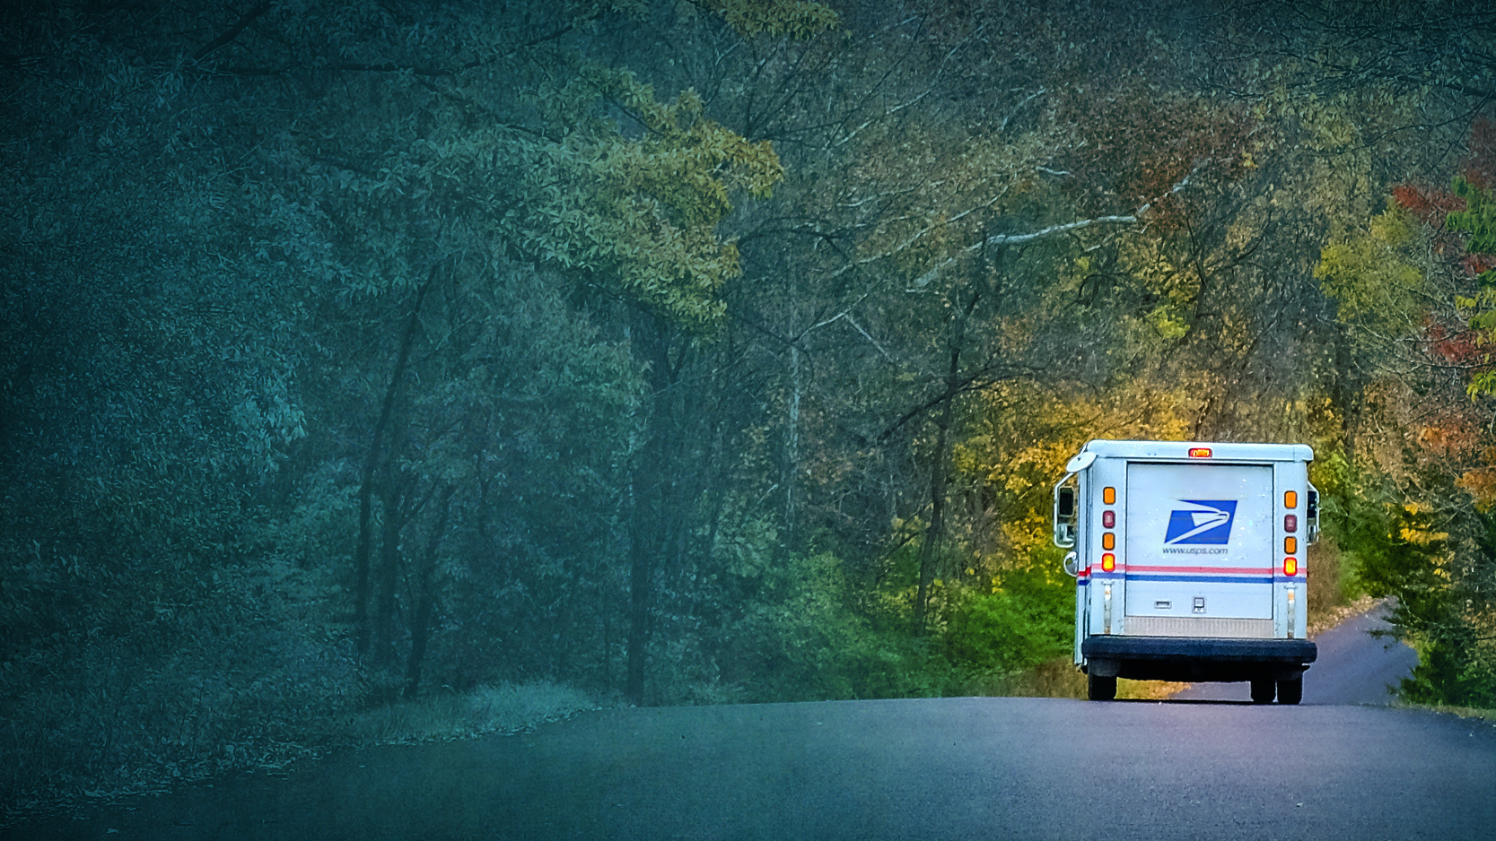
Next steps
Is this a good model?
What does market demand look like post-COVID?
Who else needs to be at the table?
What is needed of an aggregator/web portal?
Where do we pilot a program?
What government support is needed? How do we get it?

Slide 12
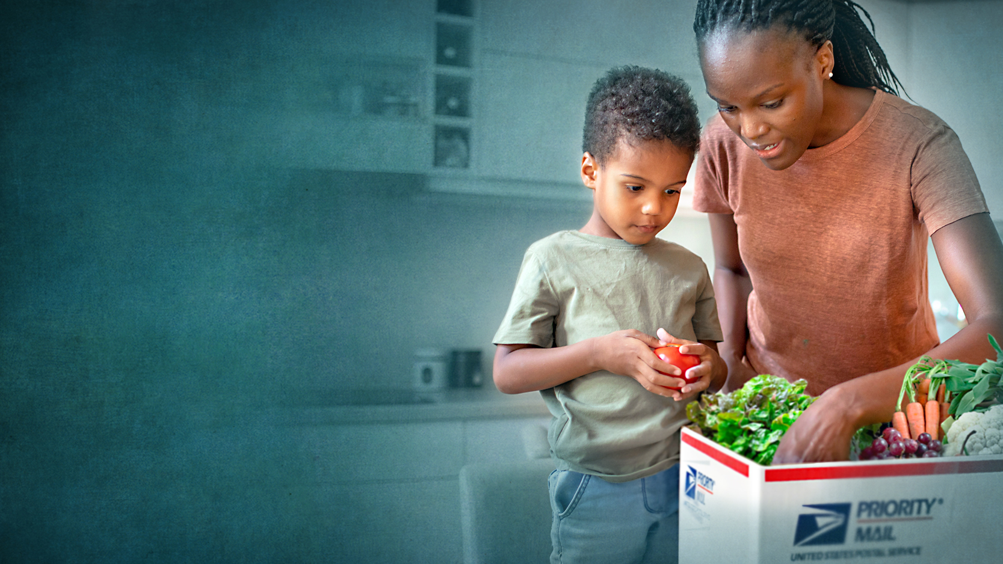
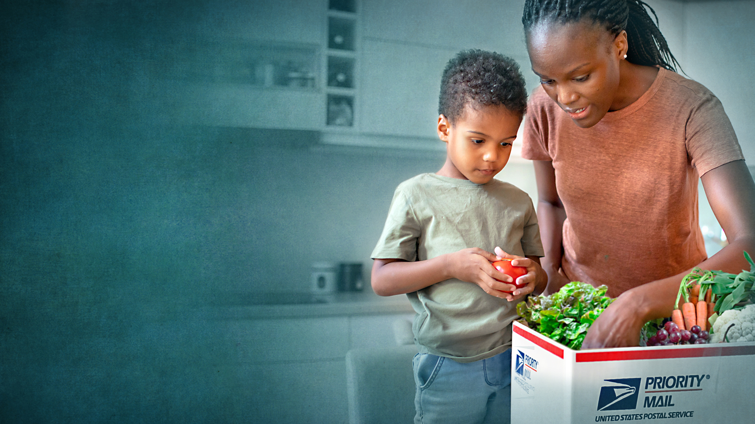
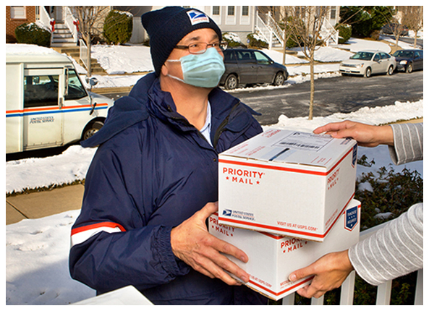
Farmers Post: Delivering Food for All
Julia.Kurnik@wwfus.org Markets Institute website: https://wwf.to/3oZjjtE

